Slide 1
EURO Working Group on Education

Slide 2

Plan
Form groups
Select a (teaching) tool
Evaluating the tool for classroom use and publication suitability.
Present results to the group

Slide 3
Evaluating Teaching Tools (game, puzzle, case, etc.)
For classroom
What factors should you consider when evaluating whether a teaching tool is appropriate and effective for usage in the classroom?
Does the tool you have selected meet these criteria?
For publication
What factors should you consider when evaluating whether a (new) teaching tool is publishable?
Does the tool you have selected meet these criteria?

Slide 4
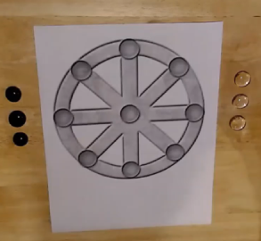
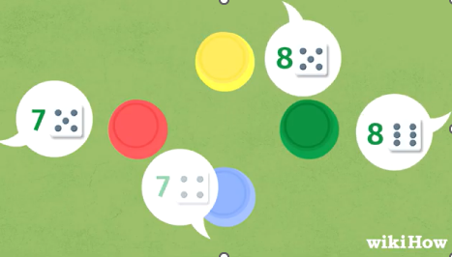
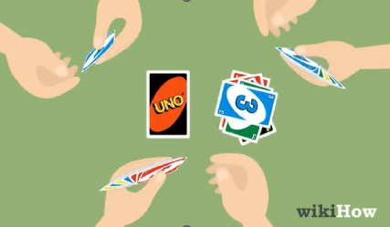
Selecting Teaching Tools - Inspiration
Rota – A board game
Liar’s Dice – A dice game
UNO – A card game

Slide 5
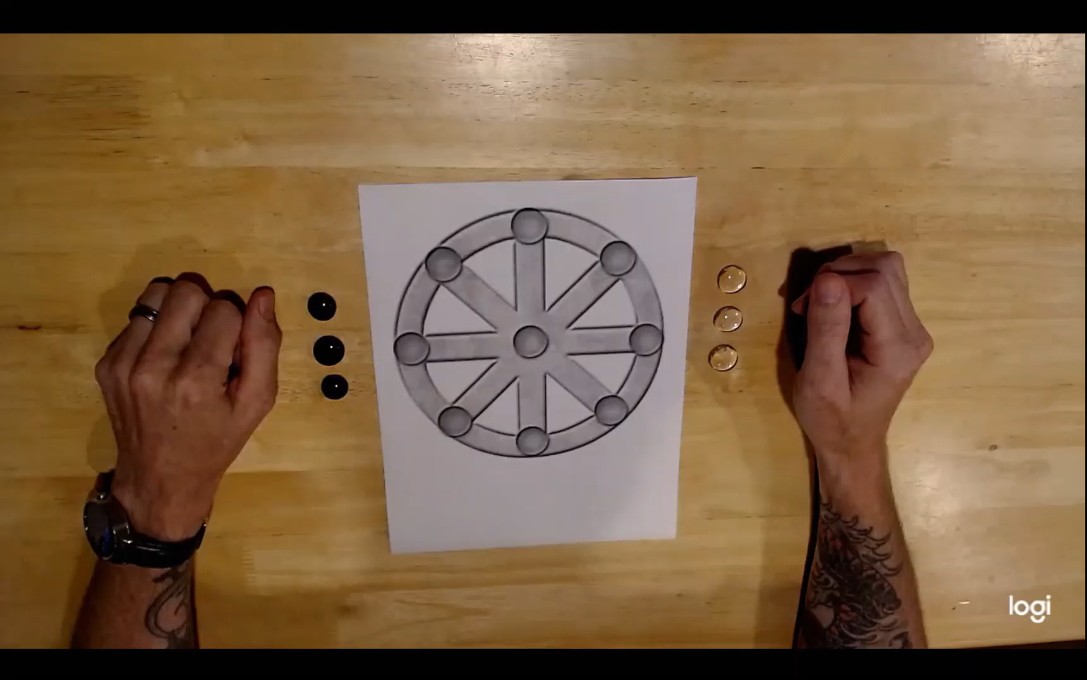
Game I: ROTA
Source: Ancient gaming - How to play Rota - YouTube (Fearghus mac Cailin, YouTube)

Slide 6
Transcript
hey everyone today i'm going to teach you how to play Rhoda. rota spelled r-o-t-a is a game from ancient rome it was found carved into the stones in many areas in rome such as buildings and roads and is believed that the soldiers or others back in that day would carve it there so that they could play the game wherever they were and they would just carry pieces with them they can use pieces such as stones or what i'm using here are just pieces of colored glass. It's a very simple board to lay out the name rota means wheel in latin as you can see it looks sort of like a wagon wheel but it's also similar to the calendar year from back then so this game was actually spoken about in two different poems by ovid the art of love and tristia and that's where we get some of the ideas and the rules from as well as from elmer truesdell Merrill who discovered it and made it more popular and that was in the early 1900s.
The rules to rota are fairly simple each player has three stones or three pieces however you wanted to use them you have a board such as this which is just a circular wheel with all connections on the outside and on the inside and players take turns placing stones on the board and then once they’re placed they can move them the object of the game is to get three in a row either on the edge or going across the middle going like this would not be considered a win so one player will place then the next player will place then the next player will place and so on until you get all your pieces on the board
Once all the pieces are on the board the next each player must move a piece if they are able on their turn so in this case black would go black would move here and then white would move so white would go here now black would move to here now since white these two pieces are blocked you're not allowed to jump pieces white would have to move this piece which would be how black would take the win three in a row it would also be considered a win if black had three in a row like this and that is how you play rota
Fairly simple game you can make it on paper you can scratch it in the dirt you can even use a piece of cloth and paint on the cloth such as this one i have here and it travels very easily let's put the pieces in punch it up tie it off with a rubber band or a hair tie and that’s that's it so thanks for watching if you have any questions please leave them in the comments and enjoy

Slide 7
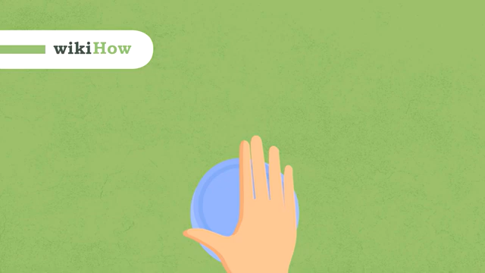
Game II: Liar’s Dice
Transcript:
Liar's dice is a fun dice game for two or more players where everyone tries to trick their opponents and be the last one standing
To play you'll need five dice for each player. each player will also need a cup so they can keep their dice hidden
To start the game each player rolls all of their dice simultaneously on the table all of the players look at what they rolled keeping their dice hidden from the other players with their cup
Then the first player states a bid consisting of one of the die faces one two three four five or six and a quantity the quantity is equal to how many of that face they think everyone at the table rolled.
For example they might bid seven fours after the first player bids the player to their left bids next they can bid a higher quantity of the same face or bid the same quantity of a higher face play continues like this clockwise around the table until a player challenges the previous player's bid
When a challenge occurs everyone reveals their dice if the bid is correct or if there are more faces than the bidder stated the bidder wins the challenge and the challenger loses one die if there are fewer faces than the bidder stated the bidder loses one die
Then a new round begins with the loser of the previous round making the first bet continue playing until only one player is left with dice and wins the game
If there are ever two players with one die each players bid the sum of the two die instead of the quantity of faces
Source: How to Play Liar's Dice - YouTube

Slide 8

Game III: UNO
Transcript:
To play UNO you'll need at least two players but the more you have the better. Start by dealing seven cards to each player. Then place the remaining cards facedown in the middle of the table. This is the draw pile. Turn the first card of the draw pile face-up and place it in a separate pile. This is the discard pile.
The first player starts by playing a card that matches either the number, color, or type of the card on top of the discard pile. If a player wants to change the color in a play for any reason they can play a wild card and choose a new color.
If the player can't play any of their cards, they must draw a card from the draw pile. If the card drawn matches the color number, or type of the card on top of the discard pile, they can play it. If not the game moves on to the next player.
As soon as a player is down to just one card, they must yell UNO before anyone else notices. If anyone else says UNO first, the player must draw two cards from the draw pile. The player that plays all of their cards wins.
As you play you, will notice several types of cards: a skip card that skips the next player, a reverse card that changes the direction of play, a draw to card that forces that next player to draw two cards and skip their turn, and a wild draw four card which is a combination of a wild and a draw card. These cards make the game even more fun.
Source: How to play UNO - YouTube

Slide 9

Link to This Presentation
Link: https://github.com/aheiX/Teaching/tree/main/Presentations

